Slide 1

Heart-Rate Monitor Watch
FULL PROJECT PROCESS
Danny Knaus

Slide 2
TABLE OF CONTENTS
Prototyping
PCB Design
01
02
Manufacturing
Final Product
03
04

Slide 3

01
PROTOTYPING
First Steps for Testing Pulse Oximeter

Slide 4
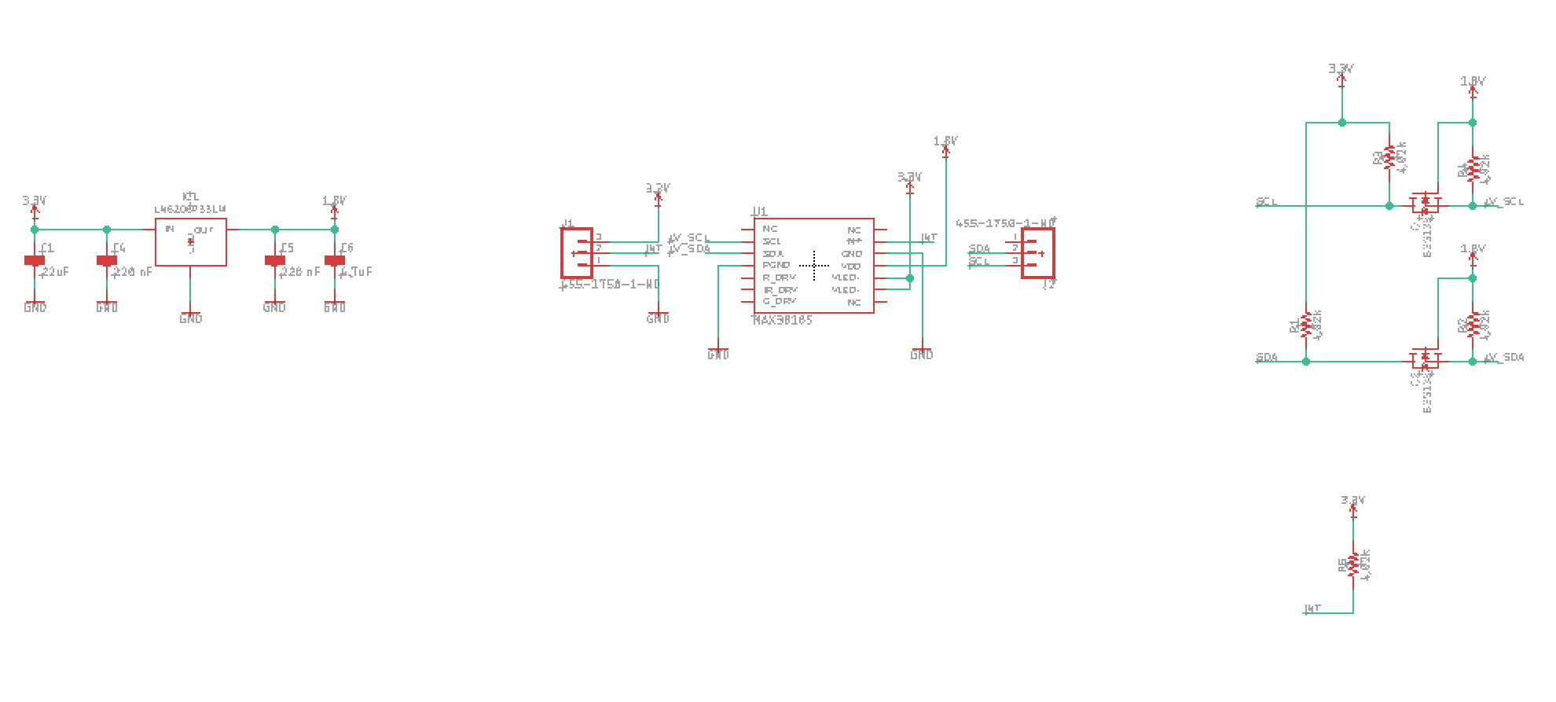
1ST SCHEMATIC (NO ESP8266)

Slide 5
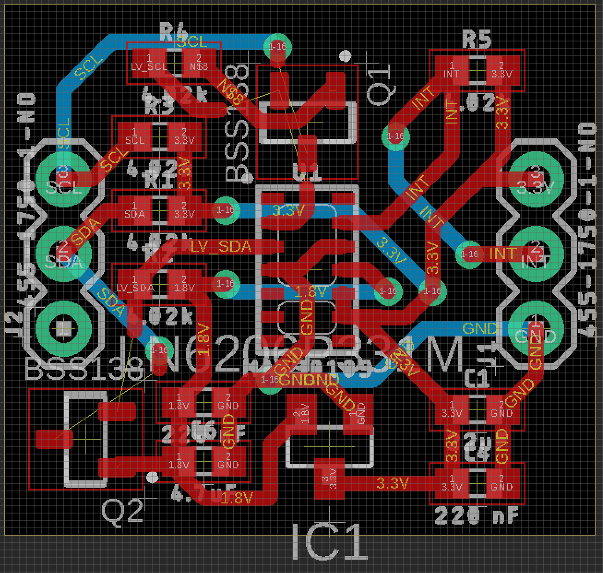
1ST PROTOTYPE (NO ESP8266)

Slide 6
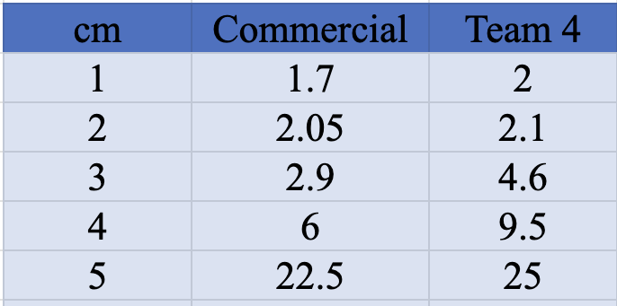
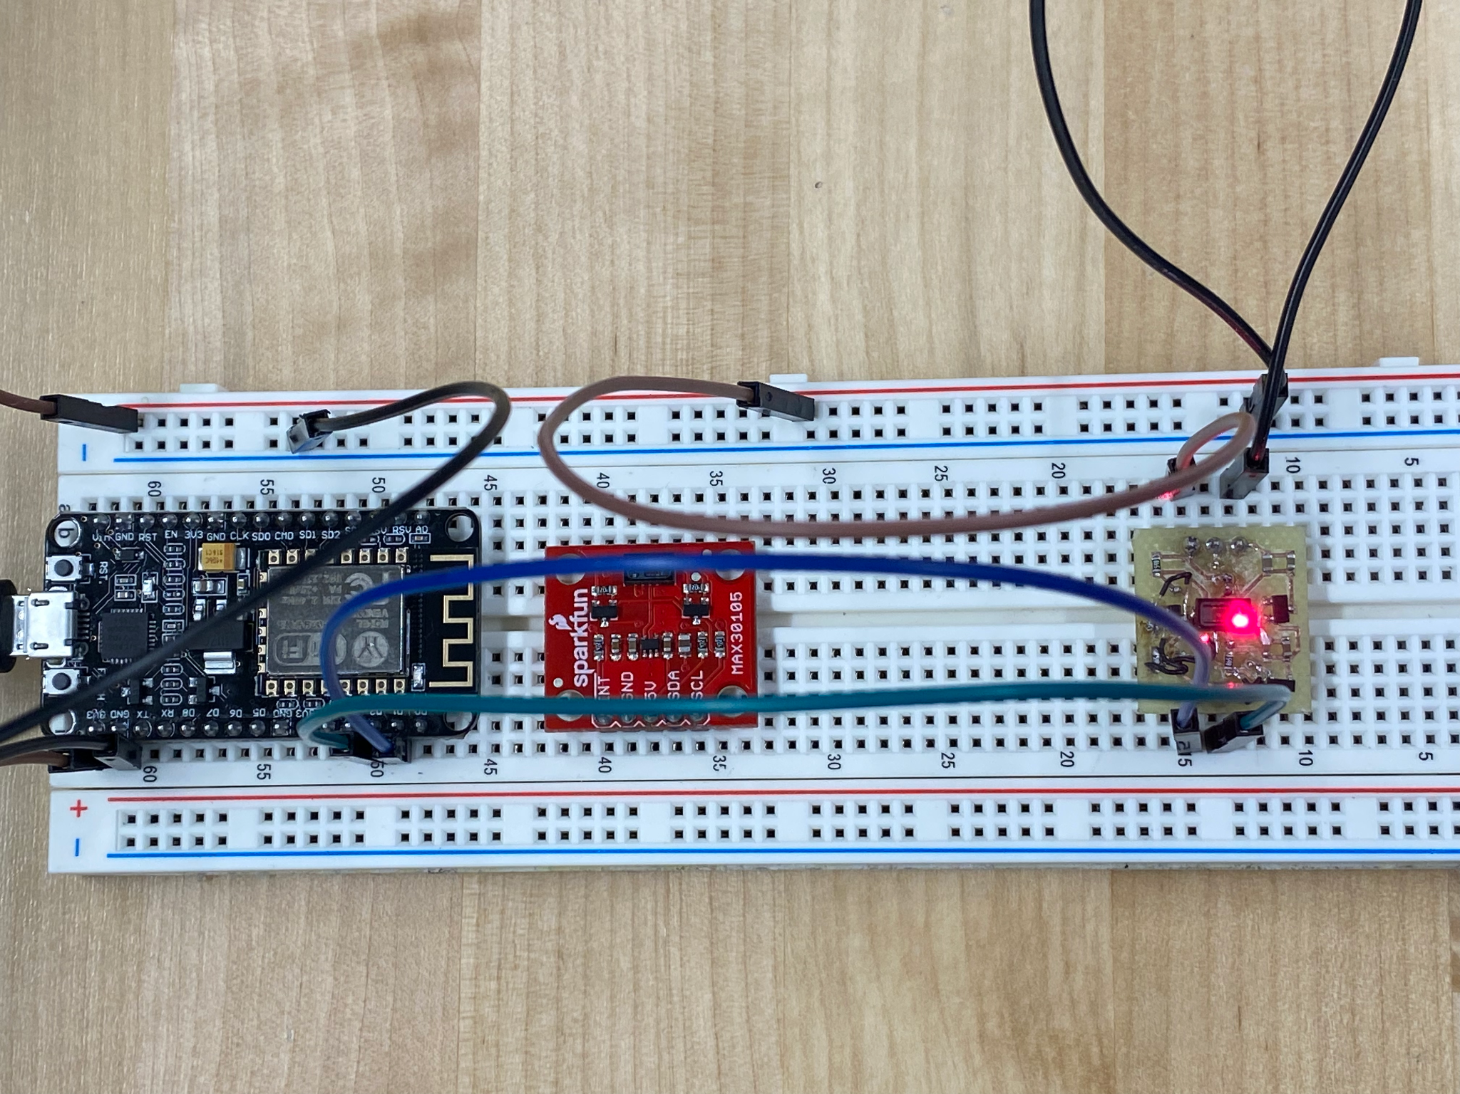
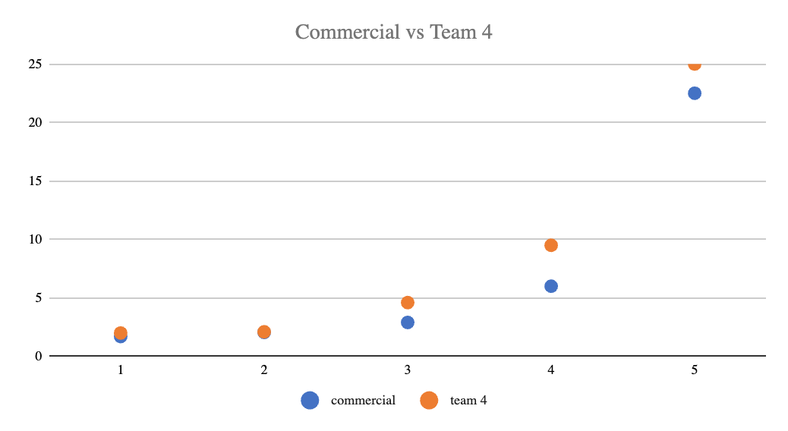
PRELIMINARY TESTING

Slide 7
02
PCB DESIGN
Full Design for PCB on Final Product

Slide 8
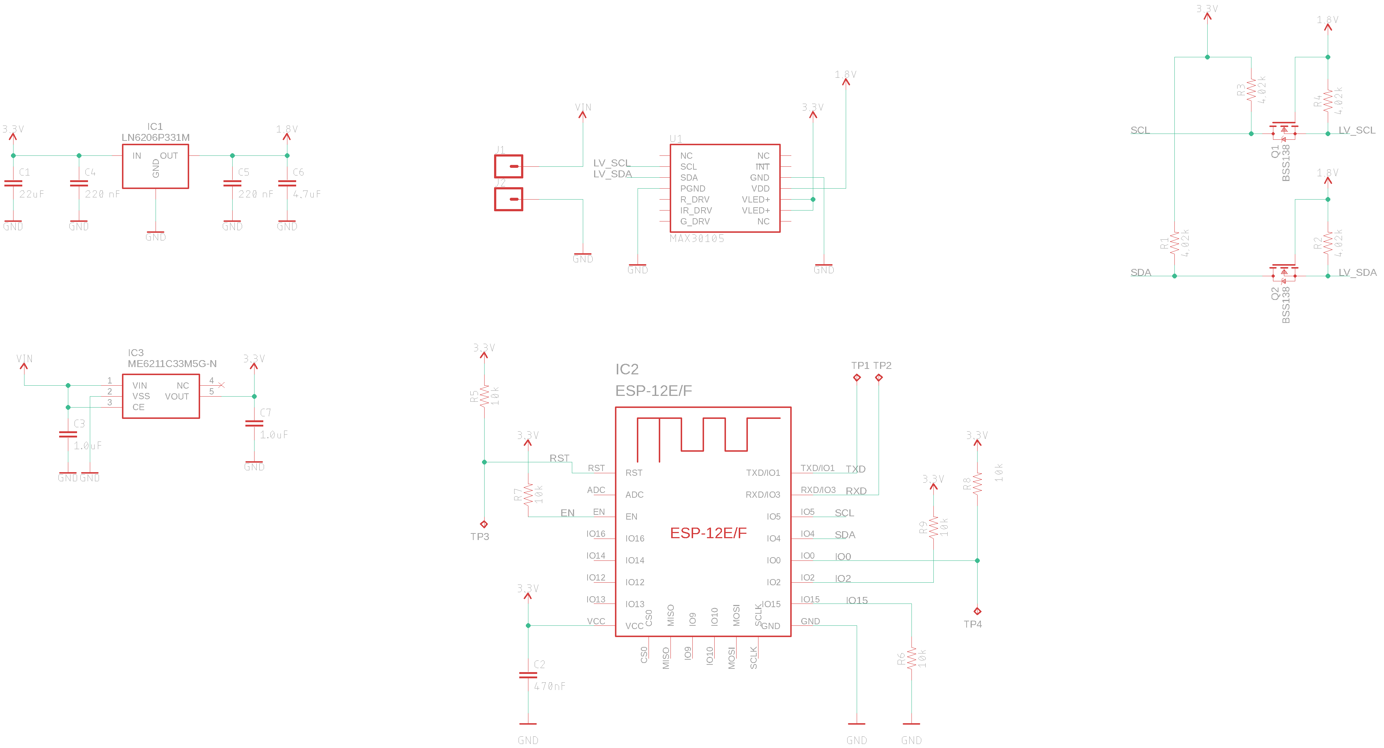
EAGLE SCHEMATIC

Slide 9
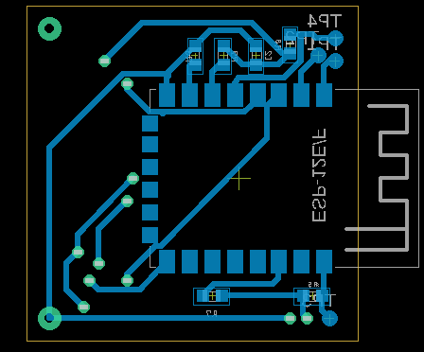
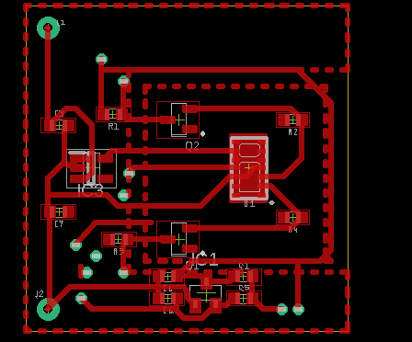
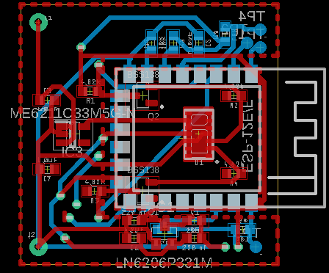
EAGLE BRD
Bottom View
Top View
Standard View

Slide 10
03
Manufacturing & Fabrication
Manufacturing Techniques Used & How

Slide 11
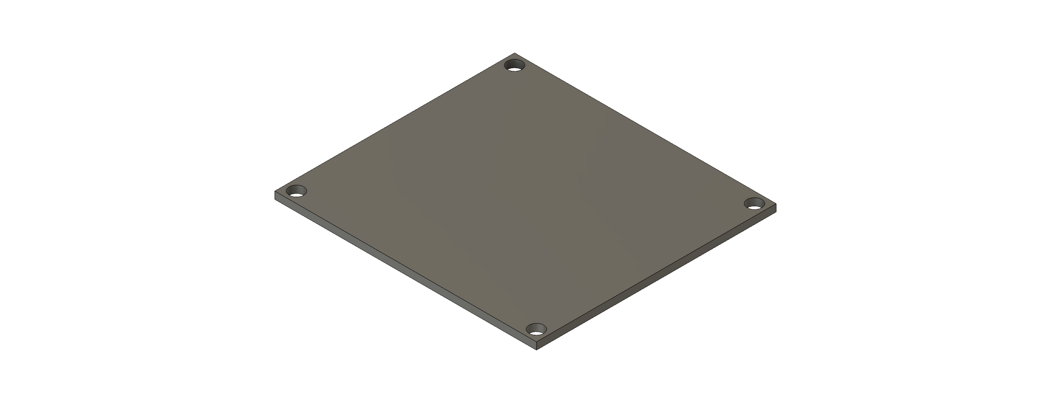
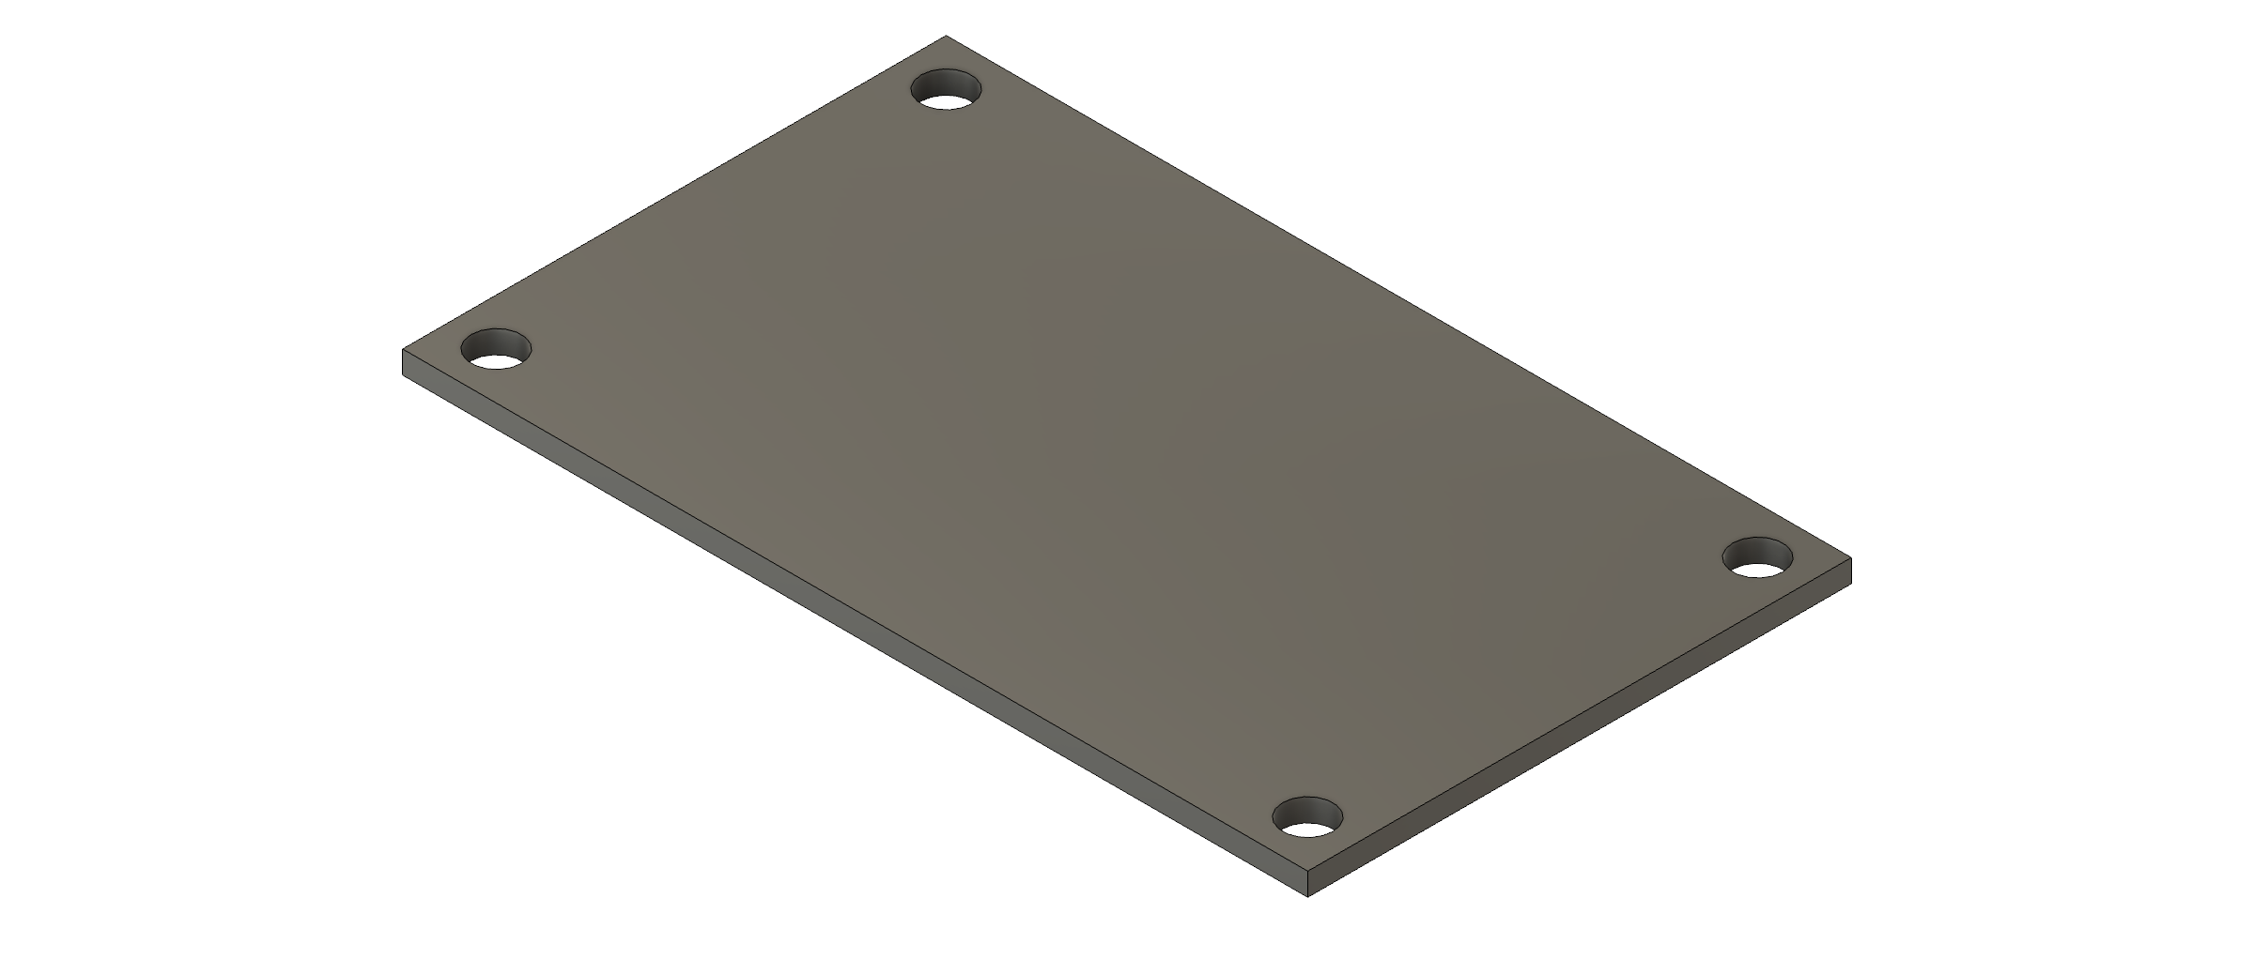
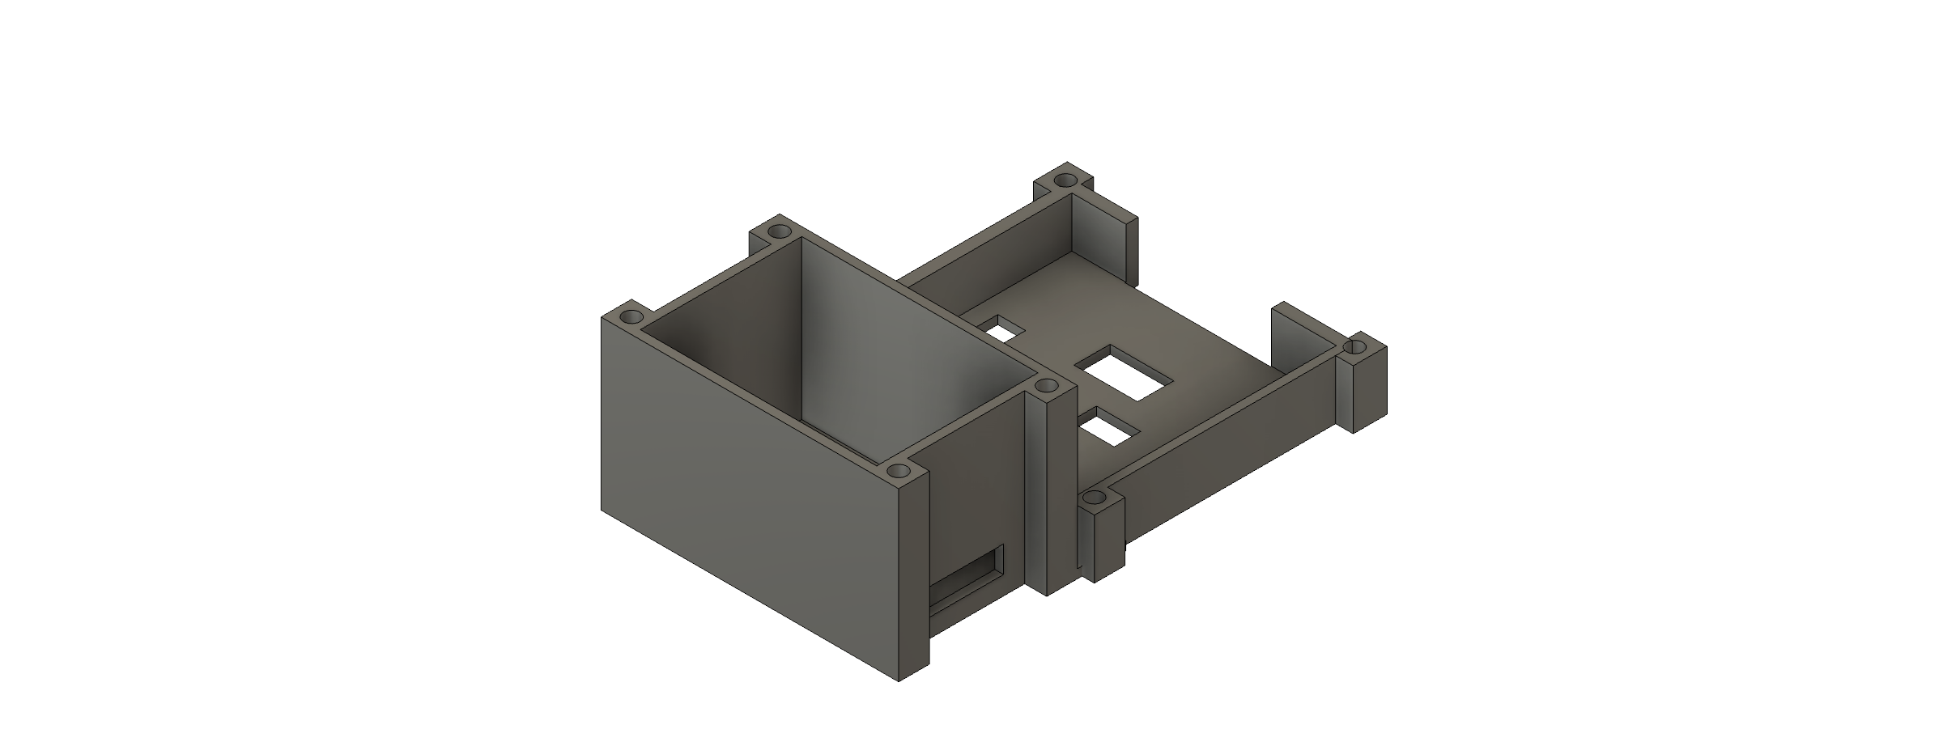
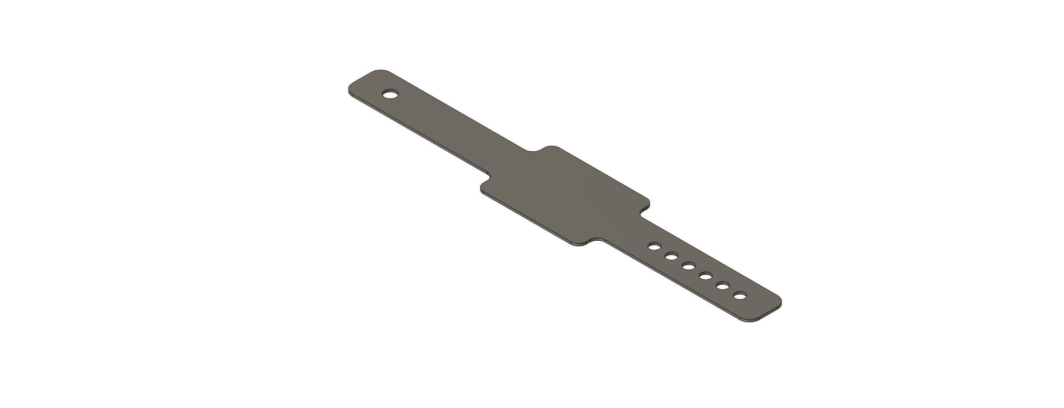

CAD DESIGNS
Mill
Water Jet
FDM 3D Printer
Laser Cutter
Lathe

Slide 12
04
Final Product
CAD Renderings and Finished Project Image

Slide 13
